Slide 1
Introduction to Psychology

Slide 2
Census Activity
On a sheet of paper, write down:
Name
Major and Year
Hobbies
Favorite video games
Any other information you want me to know about you?

Slide 3
Introduction to Psychology
What is psychology?
Science of behavior, brain, and the mind (mental processes).
Behavior
Observable actions of a person.
Mind (mental processes)
An individual’s sensations, perceptions, memories, thoughts, dreams, motives, emotions, and other subjective experiences.
Science
Can be studied using the scientific method.

Slide 4
Areas of Psychology
Clinical Psychology
Developmental
Behavioral Neuroscience
Psychometrics
Cognition
Social Psychology
Personality Psychology
Educational Psychology
Industrial/ Organizational Psychology

Slide 5
Research Methods & Design

Slide 6
Psychology as a Science
As scientists, psychologists strive to:
Describe: observe what is happening.
Explain: try to explain what is happening and why.
Predict: try to predict under what conditions the behaviors occur (make a hypothesis).
Experiment: collect data to test hypothesis.
Control: try to change or control behaviors or mental processes.

Slide 7
Facts, Theories, & Hypotheses
Fact: an objective statement based on direct observation that reasonable observers agree is true.
Theory: an explanation using an integrated set of principles that organizes observations and predicts behaviors or events.
Hypothesis: a testable prediction.
Operational definition: statement of procedures used to define research variables.

Slide 8
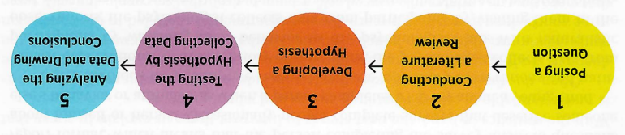
Scientific Method
Behavior and mental experiences have physical causes, so they are amenable to scientific analysis.
Scientific method
Make an observation.
Literature review.
Form a hypothesis (make prediction).
Gather data.
Analyze data.
Draw conclusions.
Report findings.

Slide 9
Research Methods
Research designs:
Experimental
Correlational
Descriptive
Setting:
Field
Laboratory
Data Collection Method:
Self-report
Observation
Case Studies

Slide 10
Research Designs: Experimental
Experiment: a procedure in which a researcher manipulates the independent variable and looks for change in the dependent variable, while keeping all other variables constant.
The only way of testing a cause-and-effect relationship between variables.
Independent variable: the variable hypothesized to cause some effect on another variable.
Dependent variable: the variable that is hypothesized to be affected.
Control variables

Slide 11
Constructs & Operational Definitions
Job Performance
Creativity
Gamer
Uses for a paperclip
Supervisor Ratings
Peer Ratings
Self Ratings
Objective Output
?

Slide 12
Types of Variables
Dichotomous vs. continuous variable
Why might a researcher choose to dichotomize a variable?
Implications of dichotomizing a continuous variable?
IV and DV Activity
Independent variable: a variable that is manipulated by the researcher.
Dependent variable: a variable that is expected to depend upon the independent variable, the outcome.
Control variable: any variable that is held constant, what stays the same.

Slide 13
Research Designs: Experimental
Representative sample: a sample that fairly represents a population because each member has an equal chance of inclusion.
Random assignment: assigning participants to experimental and control groups by chance to minimize pre-existing differences between groups.
Control group vs. experimental group
Placebo effect & double-blind procedure
Between-subjects or within-subject

Slide 14
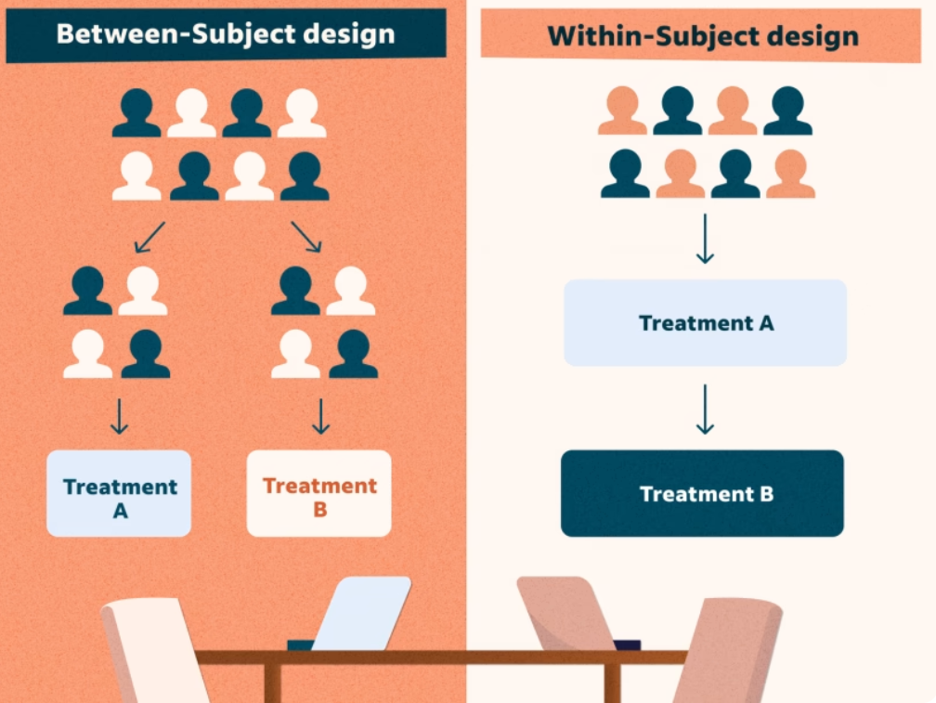
Experimental: Between-Subjects Design
Each participant serves in only one condition
Random assignment.
Compare changes in DV between groups.
Pro: Reduces demand characteristics.
Cons: Requires many participants, can have high degree of individual variability across groups.

Slide 15
Experimental: Within-Subjects Design
Repeated measures
Each participant serves in more than one IV condition.
Compare changes in DV for each participant.
Pros: requires smaller N, reduces variability from individual differences.
Cons: order effects, fatigue, sensitization.

Slide 16
Activity: Design Your Own
Start with an observation.
Form a theory.
Propose a hypothesis.
How would you design an experiment to test this? Would you use a between or within subjects design?
What is the IV? What is the DV? Controls?
What would you expect the data to show if your hypothesis is supported?

Slide 17
Research Designs: Correlational
A study in which the researcher does not manipulate any variable but observes or measures two or more variables to find relationships between them.
Can help make predictions about one variable based on knowledge of the another but does not equal causation.
Cannot rule out other variables.
Illusory correlations: an apparent relationship based on casual observations of unrelated or weakly related events.

Slide 18
Research Designs: Correlational
Correlation: a measure of the extent to which two factors vary together.
Correlation coefficient (r)
Ranges from 1.00 to -1.00.
Higher values indicate stronger correlations (absolute value).
+/- describes the relationship.
0 means no correlation, no relationship.

Slide 19
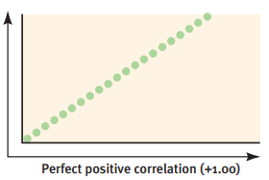
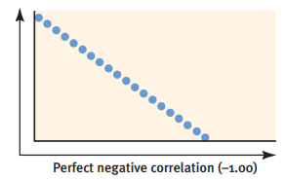
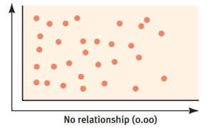
Research Designs: Correlational
Can you think of variables that may display these types of relationships?

Slide 20
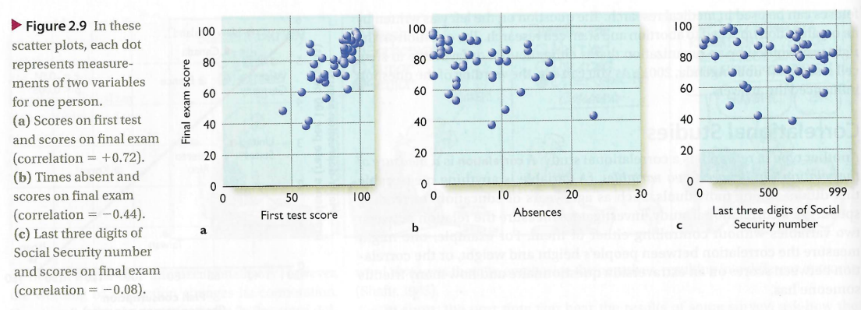
Research Designs: Correlational

Slide 21
Research Designs: Descriptive
Descriptive studies
Describe the behavior of an individual or set of individuals without systematically investigating relationships between specific variables.
Qualitative.

Slide 22
Research Settings
Laboratory: a research study in which the subjects are brought to a specially designated area that has been set up to facilitate the researcher’s collection of data or control over environmental conditions.
Pros: controlled.
Cons: might not be representative of a natural environment.
Field: a research study conducted in a setting other than a laboratory.
Cons: Results are specific to that environment.
Experimental designs tend to be in labs, field studies often correlational or descriptive.

Slide 23
Data Collection Methods
Self report: procedures in which people are asked to rate or describe their own behavior or mental state (e.g. surveys, interviews).
Pros: cheap, easy to administer, gather a lot of information quickly.
Cons: accuracy?
Observational: procedures by which researchers observe and record behavior of interest.
Naturalistic observations: avoid interfering with the behavior of the subject.
Tests: deliberately presenting stimuli to which the subject responds.
Case studies
Useful if case is rare, but can be hard to generalize.

Slide 24
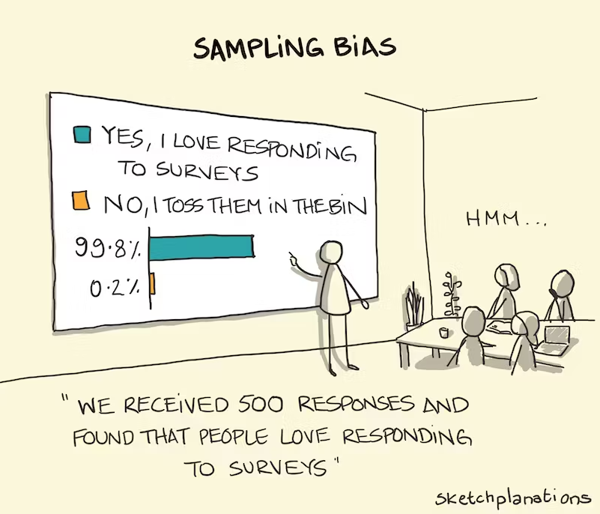
Principles of Scientific Thinking
Nothing is “proven.”
Alternative explanations for results.
Limitations of the research.
Findings need to be replicated.
Studies need to be peer reviewed.
Sampling error/bias
Size of N

Slide 25
Ethical Guidelines
Institutional Review Boards (IRB)
Research must:
Consider the rights and well-being of the participants (do no harm).
Obtain informed consent from participants.
Justify deception.
Debrief participants.
Allow participants to withdraw at any time.
Remain confidential.
Take steps necessary to minimize unforeseen outcomes of participation.

Slide 26
Validity & Reliability
Validity: does the test measure what it’s supposed to measure?
Reliability
Test-retest
Inter-rater
Internal consistency

Slide 27
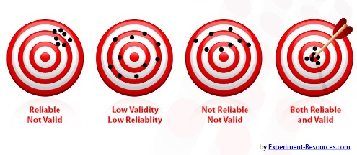
Validity & Reliability

Slide 28
Survey Design
Who is your audience?
What do you want to know/ what types of questions would you ask? (e.g. focus groups, pilot testing)
How would you operationalize your variables?
How would you ask these questions? (e.g. self-report Likert scales, open ended)
What response scale would you use? (e.g. 5 point scale, yes/no, include neutral option?)
What data analysis technique would be most appropriate?
What inferences can you make from your findings?

Slide 29
Survey Question Examples
Indicate your agreement with the following statement on a scale of 1 to 5, with 1 being strongly disagree and 5 being strongly agree:
I oppose raising taxes.

Slide 30
Survey Question Examples
Indicate your agreement with the following statement on a scale of 1 to 5, with 1 being strongly disagree and 5 being strongly agree:
I make it a practice to never lie.

Slide 31
Survey Question Examples
Indicate your agreement with the following statement on a scale of 1 to 5, with 1 being strongly disagree and 5 being strongly agree:
I would be willing to pay a few extra dollars in taxes to provide high-quality education to all children.

Slide 32
Survey Question Examples
Indicate your agreement with the following statement on a scale of 1 to 5, with 1 being strongly disagree and 5 being strongly agree:
Like all human beings, I occasionally tell a white lie.

Slide 33
Survey Design
Principles for writing survey questions:
Choose simple over specialized words.
Do not use emotionally charged terms (e.g. hate, fantastic).
Avoid vague language and/or cultural slang.
Limit the number of personal/ sensitive questions.
Keep instructions brief.
Avoid double-barreled questions.
Use a scale that covers full range of responses.
Survey Activity

Slide 34
Statistics

Slide 35
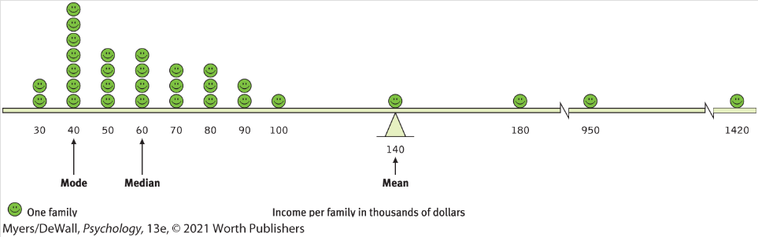
Descriptive Statistics
Central Tendency
Mode: most frequently occurring.
Median: value in the middle of the data set (midpoint).
Mean: average.
Be mindful of outliers distorting the big picture.

Slide 36
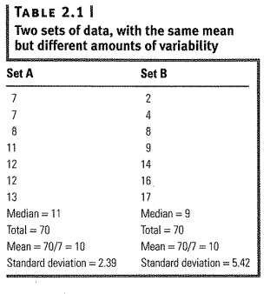
Descriptive Statistics
Measure of Variation
Range: the spread of your data from the lowest to highest value in the distribution.
Standard deviation: measure of how much scores vary around the mean score.
Outliers: 3 SD from mean.

Slide 37
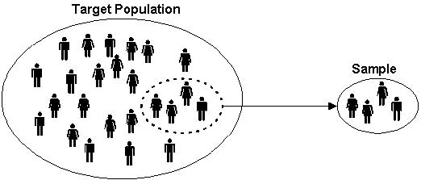
Inferential Statistics
Inferential statistics: allow you to test a hypothesis or allow you to determine whether you can generalize your findings from your sample to the broader population.
Representative sample

Slide 38
Inferential Statistics
Statistical significance: statistical statement of how likely it is that an obtained result occurred by chance.
Affected by sample size (N)
p-value: the probability that the statistical result occurred by chance.
p<.05 or p<.01
Correlations, T-tests, ANOVAs

Slide 39
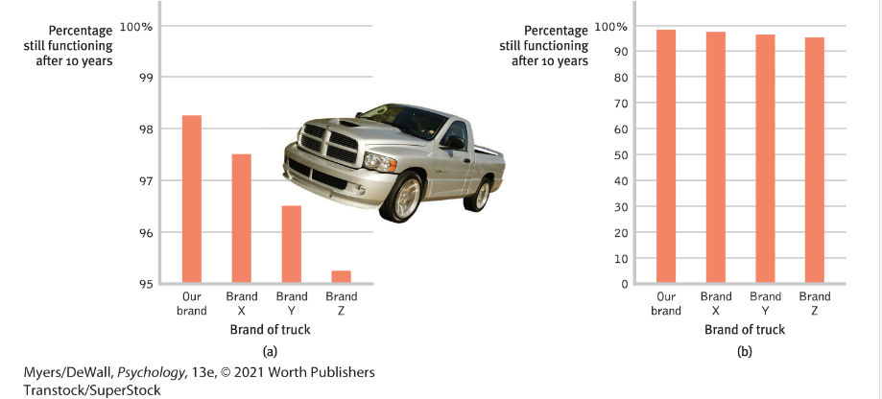
Statistical vs. Practical Significance
Practical significance (effect size)

